Slide 1


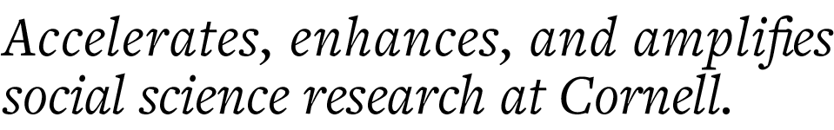
CCSS Python Machine Learning Series, Part 3 Supervised Learning
Instructor: Jonathan P. Chang
Helper: Aishat Sadiq
CCSS-ResearchSupport@cornell.edu

Slide 2
Series Overview
Introduction to Machine Learning
Unsupervised Learning
Supervised Learning
Natural Language Processing

Slide 3
Reminder: Supervised vs Unsupervised Learning
Labeled data
Unlabeled data
Supervised learning
Unsupervised learning

Slide 4
Reminder: What is Supervised Learning?
Model the relationship between independent variables (model inputs) and dependent variables (model outputs) using labeled data
Use model for prediction on new data where the labels are unknown
Research questions can be further separated into regression and classification tasks:
Regression: labels are continuous
Wage, GPA, housing prices, etc.
Classification: labels are discrete
Binary: 0/1, Yes/No, True/False
Multi-class (aka Categorical): Cat/Dog/Duck, Digit (0, 1, …, 9)

Slide 5
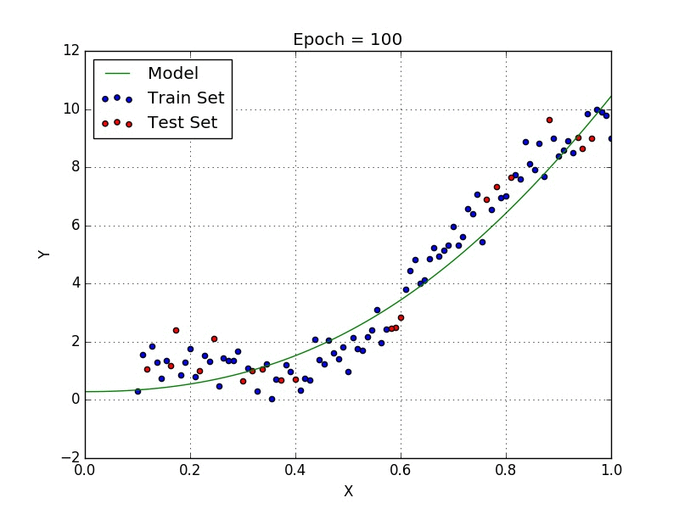
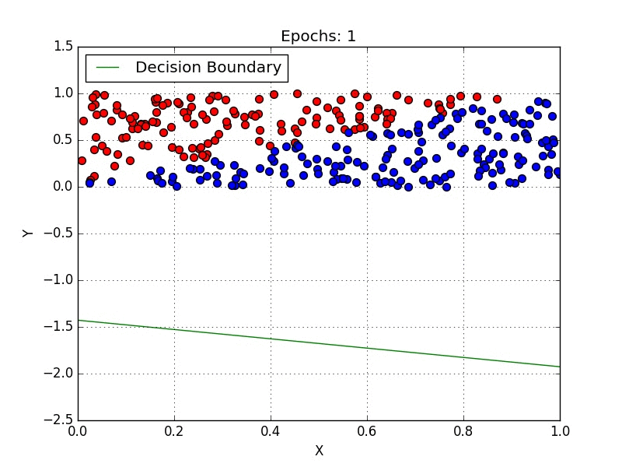
Reminder: What is Supervised Learning?
Regression
Classification
Animations by Davi Frossard (https://www.cs.toronto.edu/~frossard/)

Slide 6
Common Approach #1: Linear Models
Simple approach that works by fitting a line (or the higher-dimensional equivalent of a line) to the data
This fitting process is also referred to as "training"
Can be used for regression or classification

Slide 7
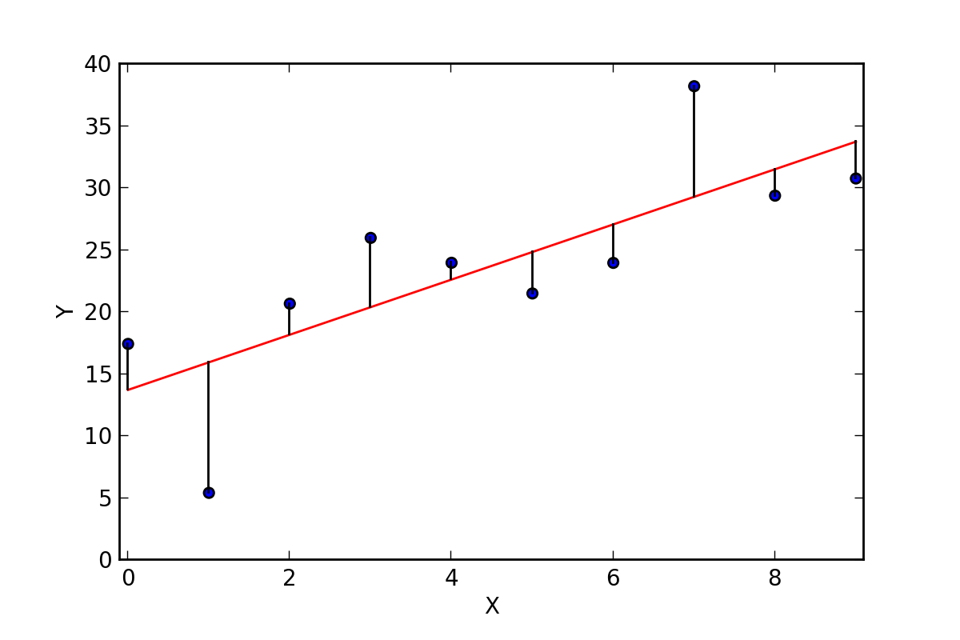
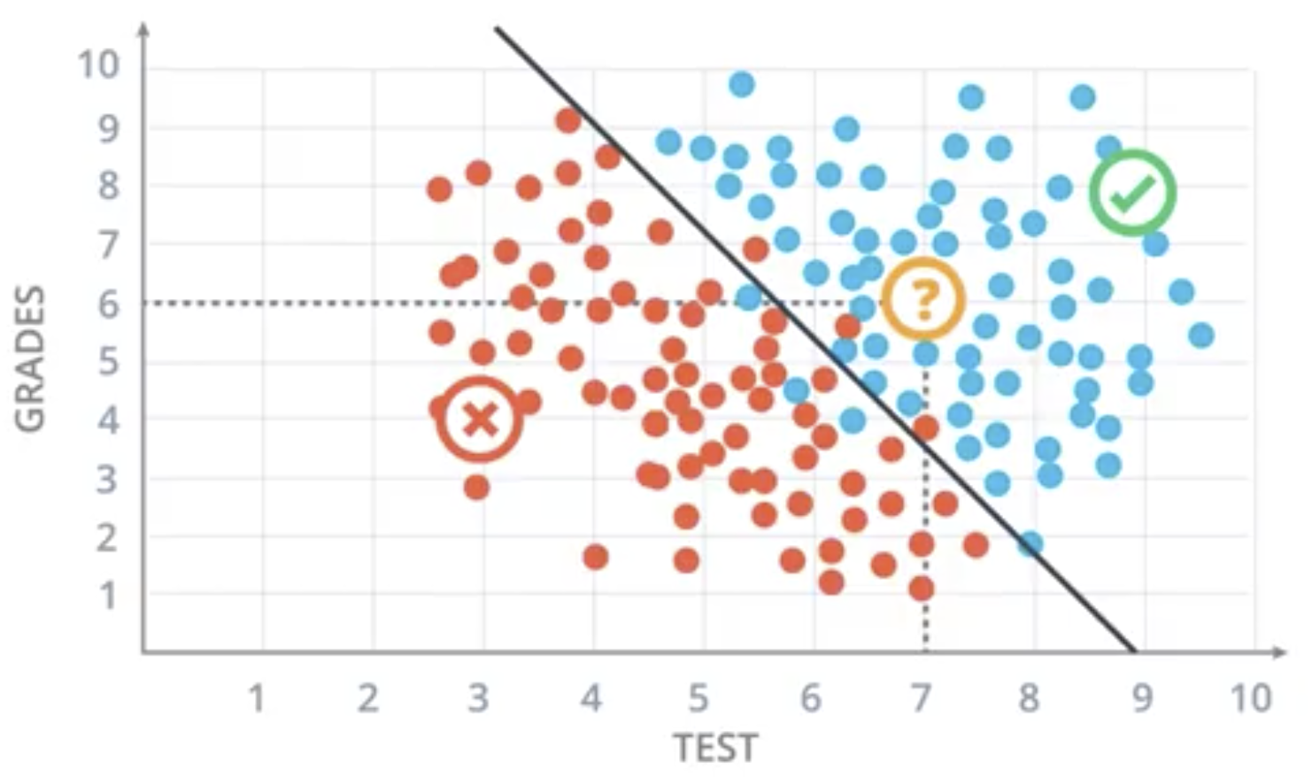
Common Approach #1: Linear Models
For regression: find a line that "best fits" the data by minimizing distance from each datapoint to the line ("mean squared error")
For classification: find a line that "best separates" the data by minimizing probability of a datapoint being on the wrong side
Linear regression
Logistic regression
(no, that's not a typo!)
(Image sources: https://ryanwingate.com/intro-to-machine-learning and Wikimedia Commons)

Slide 8
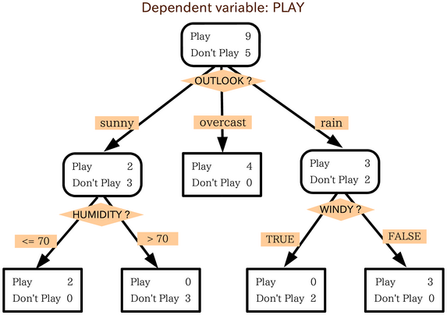
Common Approach #2: Decision Trees
Uses a series of if-then rules to classify data
Can also be adapted for regression, but this is less common
Rules are not manually written, they are learned from the data
Training is done "greedily" (i.e., through brute force): at each level, split on the feature that best separates the different classes/categories in the dataset
(Image source: Wikimedia Commons)

Slide 9
Supervised Learning in Scikit-learn
A major advantage of using scikit-learn is that all supervised learning algorithms use the same set of functions, making it easy to swap between algorithms!
A minimal supervised learning workflow:
Initialize the model
Linear regression: model = LinearRegression()
Logistic regression: model = LogisticRegression()
Decision tree: model = DecisionTreeClassifier()
Train the model
model.fit(data) will apply the corresponding training algorithm
Use the trained model to make predictions
predictions = model.predict(data)

Slide 10
How do we Know if a Model is Good?
Just because you have a model for making predictions doesn't mean those predictions are good!
Imagine a silly model where you make decisions by flipping a coin!
To evaluate a model we need to understand two things:
What do we mean (formally, mathematically) by a "good" prediction?
What predictions should we use to measure "goodness"?

Slide 11
Evaluating Models: Mathematical Measures of "Goodness"
Simplest measure of "goodness is accuracy: what percent of datapoints does the model classify correctly?
Perfect accuracy means every dog is classified as a dog, every cat is classified as a cat, etc.

Slide 12
Evaluating Models: Mathematical Measures of "Goodness"
Simplest measure of "goodness is accuracy: what percent of datapoints does the model classify correctly?
Perfect accuracy means every dog is classified as a dog, every cat is classified as a cat, etc.
A more detailed breakdown: the confusion matrix
Model Prediction
 | 0 | 1
0 | True Negative (TN) | False Positive (FP)
1 | False Negative (FN) | True Positive (TP)
True Positive Rate = fraction of actual positive datapoints that the model correctly predicts as positive = TP / (TP + FN)
False Positive Rate = fraction of actual negative datapoints that the model incorrectly predicts as positive = FP / (FP + TN)
True Label

Slide 13
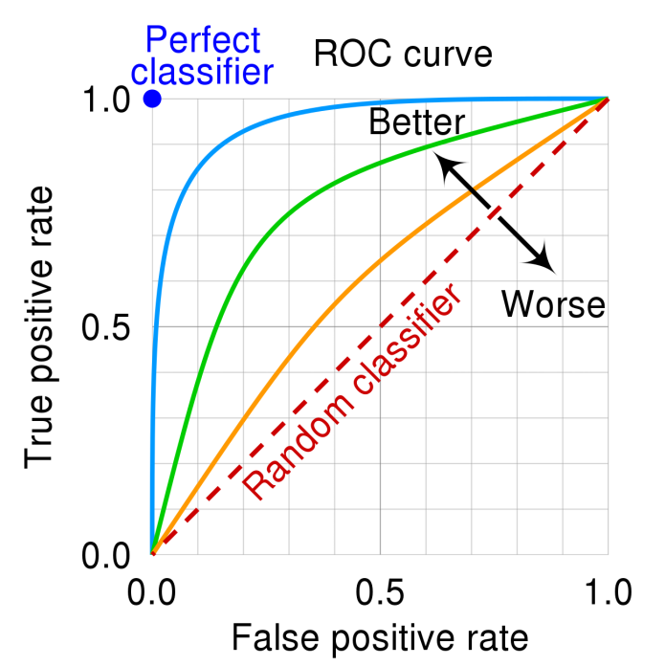
Advanced Evaluation: Receiver-Operating Characteristic
A perfect classifier has 100% True Positive Rate and 0% False Positive Rate
But in practice, classifiers lie somewhere in the middle!
To visualize, we can plot True Positive Rate vs False Positive Rate; this is called the Receiver-Operating Characteristic (ROC) Curve

Slide 14
Evaluating Models: What Data to Use?
Suppose you train a model on some data, is it fair to then evaluate the model on the same data?
Analogy: imagine you study for a test by doing a bunch of practice problems, then those practice problems show up on the test? Does getting a 100% on the test actually say anything about how much you've learned?
Takeaway: a key ingredient in what it means for a model to be "good" is generalizability: how does it perform on data it has never seen before?
Terminology note: if a model fails to generalize, we say it has been overfitted to the data it was trained on

Slide 15
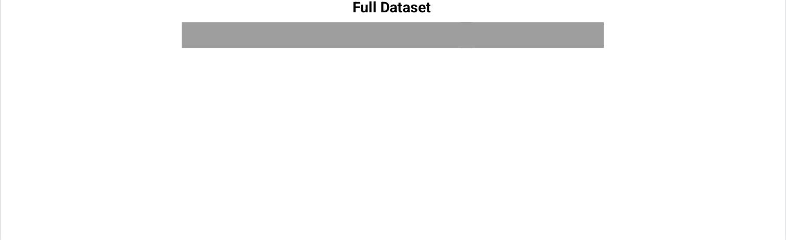
Evaluating Models: Measuring Generalizability

Slide 16
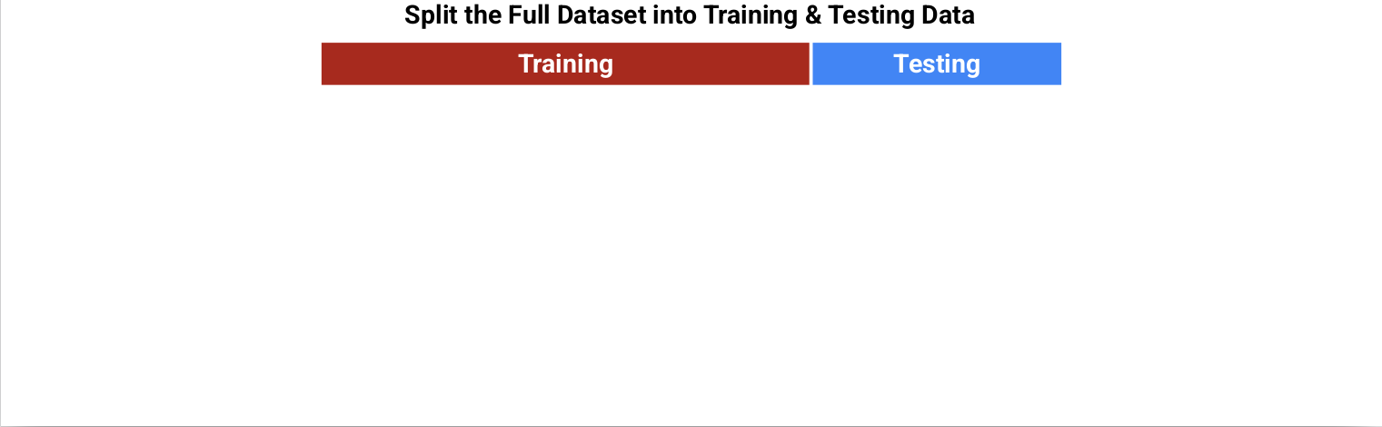
Evaluating Models: Measuring Generalizability

Slide 17
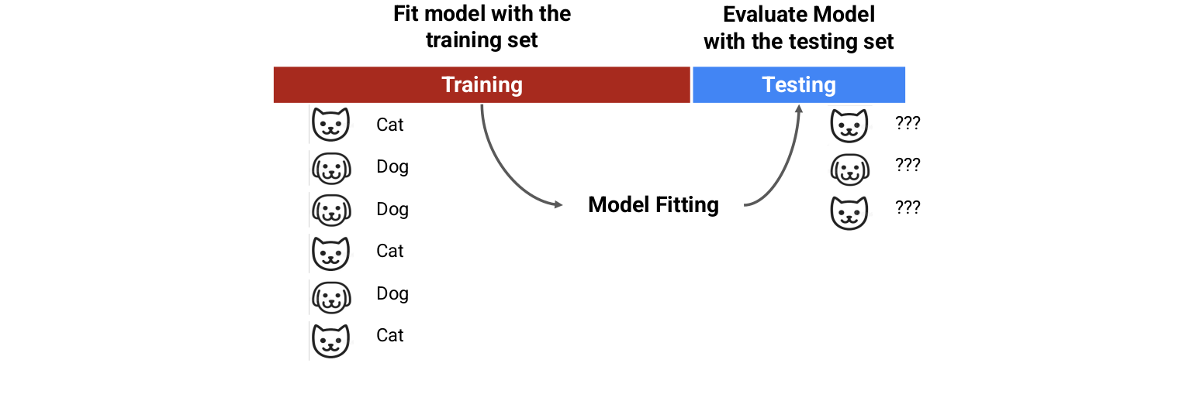
Evaluating Models: Measuring Generalizability

Slide 18
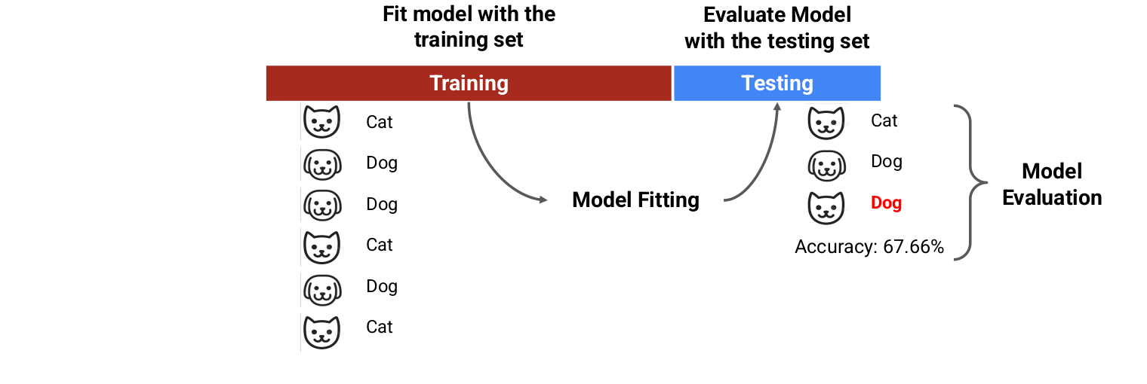
Evaluating Models: Measuring Generalizability

Slide 19
Coding Demo

Slide 20
Beyond the Minimal Workflow: Improving Your Model
So your model's accuracy isn't as high as you want – what to do next?
Could try using different types of model (e.g., linear model instead of decision tree)
Or, can try to tweak the model you have by changing hyperparameters
Hyperparameters are "knobs you can turn" to change the behavior of a model
Example of a hyperparameter: maximum depth of the decision tree

Slide 21
Hyperparameter Tuning and Generalization
Don't just randomly mess with hyperparameters! Your ultimate goal is to improve the model's generalization
Regularization: the process of reducing complexity in your model to prevent overfitting
In decision trees, regularization is achieved by picking a smaller max depth
In linear models, regularization is achieved by penalizing large coefficients
Coefficients of a linear model: Y = ax + by + cz + …
Lasso regularization imposes penalties based on absolute value of coefficients
Ridge regularization imposes penalties based on the square of the coefficients
"Regularization strength" hyperparameter (called "C" in scikit-learn) controls how much penalization is applied

Slide 22

Comparing Models
Suppose your linear model gets 1% higher accuracy than your decision tree: is this a real improvement, or is it just noise?
Cross-validation: do the train-test split multiple times, and average results across all test sets (goal is to average away the noise effects)
(Image source: scikit-learn documentation)

Slide 23
A More Complete Supervised Learning Workflow
Choose models to compare
Choose hyperparameter values to try
Do cross-validated training and testing
Compare average model performance

Slide 24
Beyond the Basics
Linear models and decision trees are two extremely common approaches to supervised learning, but they are not the only ones
Many advanced supervised learning approaches involve nonlinear models:
Kernel Support Vector Machines
Neural Networks (aka "Deep Learning")
For social science research, you will probably never need anything more complicated than a linear model or a decision tree!

Slide 25
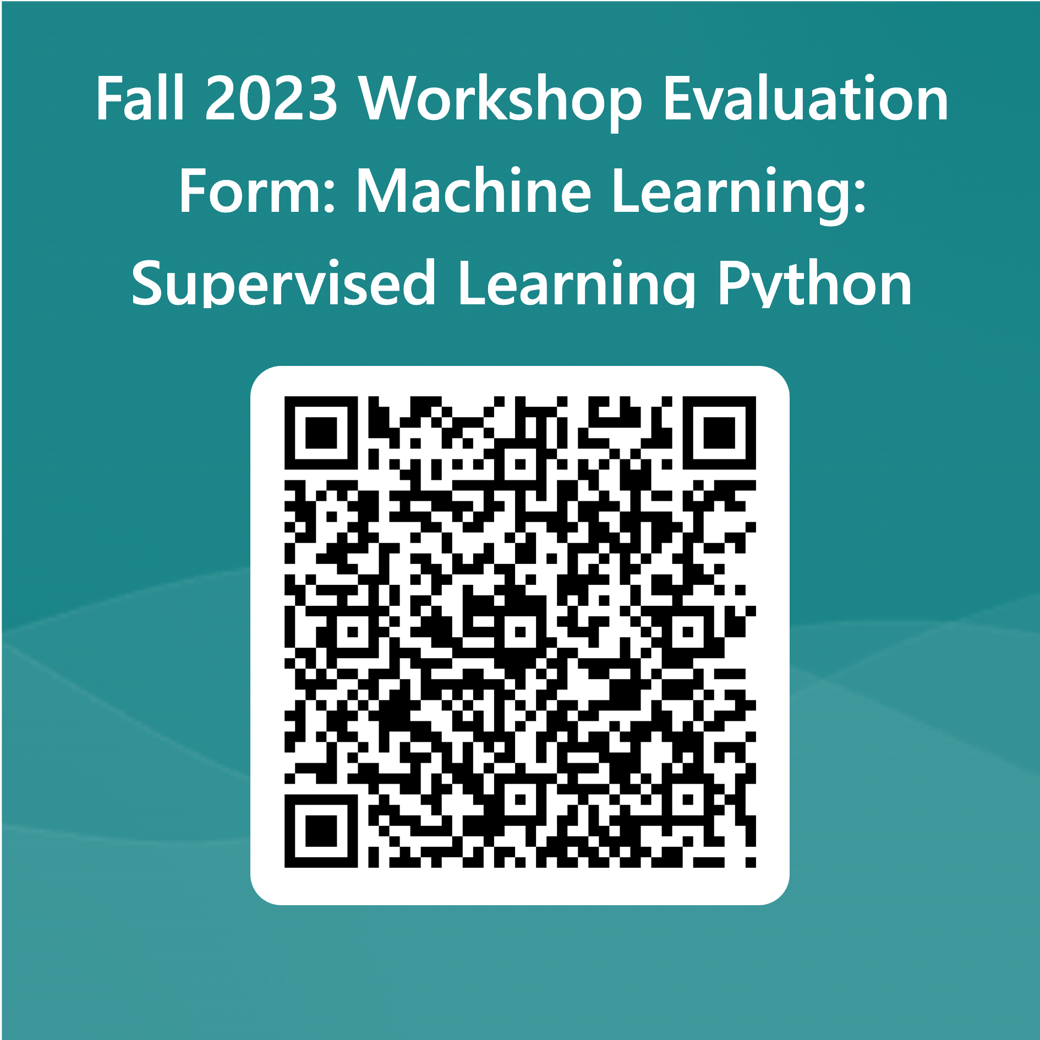
Thank you! Questions?

